Slide 1
Milestones Experiment

Slide 2
Participants
Recruitment
Pre-survey
Goals
Balance the candidates
Avoid JabRef experts
Avoid very low experience
Scheduled
2 Pilot experiments
20 participants
Executed
15 experiments
14 Survey answers
10 Complete Survey answers
(1 invalid – Got the PR answer)

Slide 3
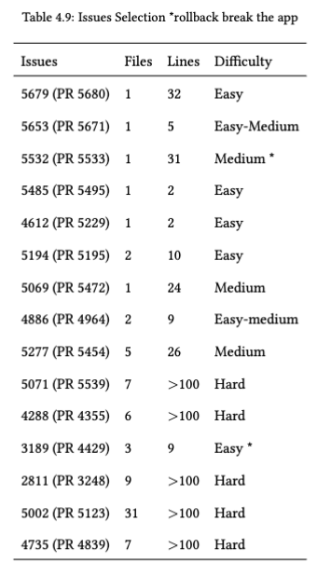
Issue Selection
Started with 30
Read text and description
15 – deep evaluation
# files changed
# lines changed
Difficulty level evaluation
7 Persisted
After 10 experiments
2 abandoned due to not being selected in any experiment

Slide 4
Issues
Control |  |  |  |  |  | Issue | Treatment
 |  |  |  |  |  | 5679 | rm2878
 |  |  | st2364 | kv582 | ap3535 | 5485 | ffs | vg588 | ma3932
 |  |  |  | sm4332 | gummadisk99 | 4612 | gk325
 |  |  |  |  | sb3292 | 5194
 |  |  |  | klp468 | nk545 | 5069 | hk486 | jk2396

Slide 5
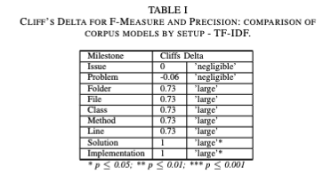
Milestones - Times

Slide 6
Milestones - Correctness
Correctness was evaluated by examining the proposed answers and code.
When there was no code, by a perfect match. Ex: file changed
When the code was available, we ran the code and also examined the proposed changes
The proposed solution (written) was examined to verify the soundness
Mean:
Control – 0.71
Treatment – 2.37
Median:
Control – 0.0
Treatment – 1.0
Legend:
Black – Control
Grey – Treatment

